Slide 1
Oil tankers

Slide 2
Contents
Oil tankers
Size categories
structural design
Cargo operations
Tank cleaning
Special type of tankers

Slide 3
Oil tankers
Crude tankers move large quantities of unrefined crude oil from its point of extraction to refineries.
Product tankers, generally much smaller, are designed to An oil tanker, also known as a petroleum tanker, is a ship designed for the bulk transport of oil. There are two basic types of oil tankers: the crude tanker and the product tanker.
move petrochemicals from refineries to points near consuming markets.
Oil tankers are often classified by their size as well as their occupation. The size classes range from inland or coastal tankers of a few thousand metric tons of deadweight (DWT) to the mammoth ultra large crude carriers (ULCCs) of 550,000 DWT.

Slide 4
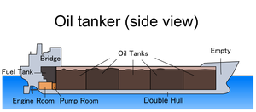

Slide 5
Size categories AFRA scale
Class Size in DWT
1.General Purpose tanker 10,000–24,999
2.Medium Range tanker 25,000–44,999
3.LR1 (Large Range 1) 45,000–79,999
4.LR2 (Large Range 2) 80,000–159,999
5.VLCC (Very Large Crude Carrier) 160,000–319,999
6.ULCC (Ultra Large Crude Carrier) 320,000–549,999

Slide 6
Structural design
Oil tankers generally have from 8 to 12 tanks. Each tank is split into two or three independent compartments by fore-and-aft bulkheads. The tanks are numbered with tank one being the forward most. Individual compartments are referred to by the tank number and the athwartships position, such as "one port", "three starboard", or "six center."
A cofferdam is a small space left open between two bulkheads, to give protection from heat, fire, or collision. Tankers generally have cofferdams forward and aft of the cargo tanks, and sometimes between individual tanks. A pumproom houses all the pumps connected to a tanker's cargo lines. Some larger tankers have two pumprooms. A pumproom generally spans the total breadth of the ship.

Slide 7
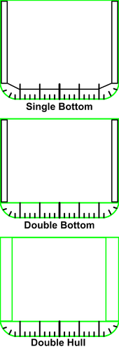
Hull design
A major component of tanker architecture is the design of the hull or outer structure. A tanker with a single outer shell between the product and the ocean is said to be single-hulled. Most newer tankers are double-hulled, with an extra space between the hull and the storage tanks. Hybrid designs such as double-bottom and double-sided combine aspects of single and double-hull designs. All single-hulled tankers around the world will be phased out by 2026, in accordance with the International Convention for the Prevention of Pollution from Ships ,1973 (MARPOL). The United Nations has decided to phase out single hull oil tankers by 2010.

Slide 8
Inert gas system
An oil tanker's inert gas system is one of the most important parts of its design. Fuel oil itself is very difficult to ignite, but its hydrocarbon vapors are explosive when mixed with air in certain concentrations.The purpose of the system is to create an atmosphere inside tanks in which the hydrocarbon oil vapors cannot burn. Inert gas systems deliver air with an oxygen concentration of less than 5% by volume. As a tank is pumped out, it's filled with inert gas and kept in this safe state until the next cargo is loaded. The exception is in cases when the tank must be entered. Safely gas-freeing a tank is accomplished by purging hydrocarbon vapors with inert gas until the hydrocarbon concentration inside the tank is under about 1%. Thus, as air replaces the inert gas, the concentration cannot rise to the lower flammable limit and is safe.

Slide 9
Cargo operations
Loading cargo
Loading an oil tanker consists primarily of pumping cargo into the ship's tanks. As oil enters the tank, the vapors inside the tank must be somehow expelled. Depending on local regulations, the vapors can be expelled into the atmosphere or discharged back to the pumping station by way of a vapor recovery line. It is also common for the ship to move water ballast during the loading of cargo to maintain proper trim. Loading starts slowly at a low pressure to ensure that equipment is working correctly and that connections are secure. Then a steady pressure is achieved and held until the "topping-off" phase when the tanks are nearly full. Topping off is a very dangerous time in handling oil, and the procedure is handled particularly carefully. Tank-gauging equipment is used to tell the person in charge how much space is left in the tank, and all tankers have at least two independent methods for tank-gauging. As the tanker becomes full, crew members open and close valves to direct the flow of product and maintain close communication with the pumping facility to decrease and finally stop the flow of liquid.

Slide 10
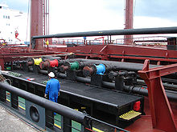
Oil is pumped on and off the ship by way of connections made at the cargo manifold

Slide 11
Unloading of cargo
This cargo pump aboard a VLCC can move 5,000 cubic meters of product per hour.
The process of moving oil off of a tanker is similar to loading, but has some key differences. The first step in the operation is following the same pretransfer procedures as used in loading. When the transfer begins, it is the ship's cargo pumps that are used to move the product ashore. As in loading, the transfer starts at low pressure to ensure that equipment is working correctly and that connections are secure. Then a steady pressure is achieved and held during the operation. While pumping, tank levels are carefully watched and key locations, such as the connection at the cargo manifold and the ship's pumproom are constantly monitored. Under the direction of the person in charge, crew members open and close valves to direct the flow of product and maintain close communication with the receiving facility to decrease and finally stop the flow of liquid.

Slide 12
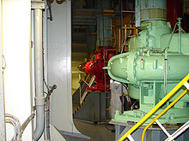
This cargo pump aboard a VLCC can move 5,000 cubic meters of product per hour.

Slide 13
Tank cleaning
Tanks must be cleaned from time to time for various reasons. One reason is to change the type of product carried inside a tank. Also, when tanks are to be inspected or maintenance must be performed within a tank, it must be not only cleaned, but made "gas-free.
On most crude-oil tankers, a special crude oil washing (COW) system is part of the cleaning process. The COW system circulates part of the cargo through the fixed tank-cleaning system to remove wax and asphaltic deposits. Tanks that carry less viscous cargoes are washed with water. Fixed and portable automated tank cleaning machines, which clean tanks with high-pressure water jets, are widely used. Some systems use rotating high-pressure water jets to spray hot water on all the internal surfaces of the tank. As the spraying takes place, the liquid is pumped out of the tank.

Slide 14
After a tank is cleaned, provided that it is going to be prepared for entry, it will be "purged". Purging is accomplished by pumping inert gas into the tank until hydrocarbons have been sufficiently expelled. Next the tank is "gas freed" which is usually accomplished by blowing fresh air into the space with portable air powered or water powered air blowers. "Gas freeing" brings the oxygen content of the tank up to 20.8% O2. This process ensures the tank never has an atmosphere capable of ignition. Specially trained personnel monitor the tank's atmosphere, often using hand-held gas indicators which measure the percentage of hydrocarbons present. After a tank is gas-free, it may be further hand-cleaned in a manual process known as mucking. Mucking requires protocols for entry into confined spaces, protective clothing, designated safety observers, and possibly the use of airline respirators.

Slide 15
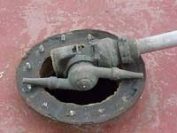
The nozzle of the automated cleaning machine

Slide 16
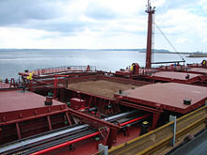
Special type oil tankers Ore-bulk-oil carriers
The OBO-carrier Maya. The picture is showing both the cargo hold hatches used for bulk and
the pipes used for oil
An ore-bulk-oil carrier, also known as
combination carrier or OBO, is a
ship designed to be capable of carrying
wet or dry bulk cargoes. This design
was intended to provide flexibility in
two ways. Firstly, an OBO would be able to shift between the dry and wet bulk trades based on market conditions. Secondly, an OBO could carry oil on one leg of a voyage and return carrying dry bulk, reducing the number of unprofitable ballast voyages it would have to make.

Slide 17
In practice, the flexibility which the OBO design allows
has gone largely unused, as these ships tend to specialize
in either the liquid or dry bulk trade. Also, these ships
have endemic maintenance problems. On one hand, due to
a less specialized design, an OBO suffers more from wear
and tear during dry cargo on load than a bulker. On the
other hand, components of the liquid cargo system,
from pumps to valves to piping, tend to develop
problems when subjected to periods of disuse. These
factors have contributed to a steady reduction in the number
of OBO ships worldwide since the 1970s.
One of the more famous OBOs was the MV Derbyshire
of 180,000 DWT which in September 1980 became the
largest British ship ever lost at sea. It sank in a Pacific
typhoon while carrying a cargo of iron ore from Canada to Japan.

Slide 18
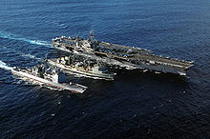
Replenishment ships
Replenishment ships, known as
oilers in the United States and
fleet tankers in Commonwealth
countries, are ships that can
provide oil products to naval
vessels while on the move.
This process, known as
underway replenishment, extends the length of time a naval vessel can stay at sea, as well as her effective range. Prior to underway replenishment, naval vessels had to enter a port or anchor to take on fuel. In addition to fuel, replenishment ships may also deliver water, ammunition, rations, stores and personnel.

Slide 19
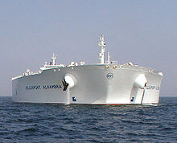
Hellespont Alhambra (now TI Asia), a ULCC TI classsupertanker

Slide 20
THANK YOU
THANK YOU

